Slide 1

A Scout’s Guide to the Eagle Scout Paperwork Submission Process
Scouting America- Twin Rivers Council

Slide 2
Twin Rivers Council’s procedure for Eagle Scout processing
Steps include:
Contacting Your District for Project Approval;
Requesting a Board of Review; and
Best Practices throughout the Eagle Scout Application Process

Slide 3
Best Practices for Scouts
Be prepared to talk about your project and the leadership you displayed during the project
Bring/include pictures of your project for your Board of Review
Triple check your paperwork before submitting it - any missing information will lead to delays in processing Project Applications and Board of Review applications.
Be prepared to talk about your experiences during scouting – camp outs, favorite memories, best/worst merit badges, etc.
Notes:
When talking about project/leadership; the easiest way to do this is to fill out the voluntary section on your application which asks how did you display leadership?

Slide 4
Best Practices for Unit Leaders
Be available to scouts throughout the process:
Ensure that Scoutbook/Scout advancement and leadership history is accurate before the Scout submits a Board of Review request.
Help scouts prepare for their Board of Review
Notes:
Be available especially to review their Eagle Scout Service Project Workbook and Board of Review applications. If something is missing, have those conversations with the scouts as early as possible.
Scoutbook- Be particularly mindful of the time in leadership at various rank requirements (even a few days can lead to a denial at the National Review Level).

Slide 5
Contacting Your District
You cannot begin your project until you have received your District’s Eagle Advancement Chair’s approval.
This should be done(using the upload link located on the Council’s Website (Advancement section under Scout Rank Advancement)
https://forms.gle/T5AS8fHxVSdtK8Ct5
Notes:
Email should identify: the issue encountered and provide all documents that would have been required for submission using the council website.

Slide 6

What Does The Upload Form Look Like?

Slide 7
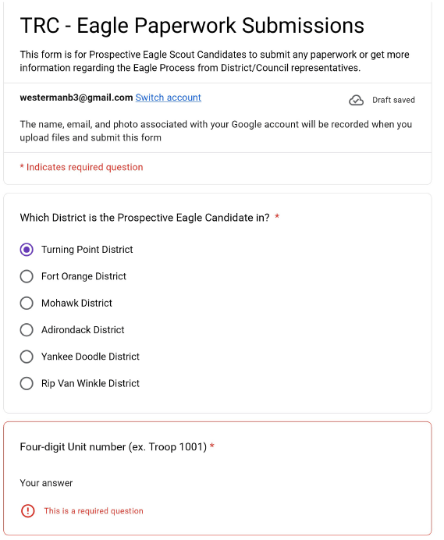

Slide 8
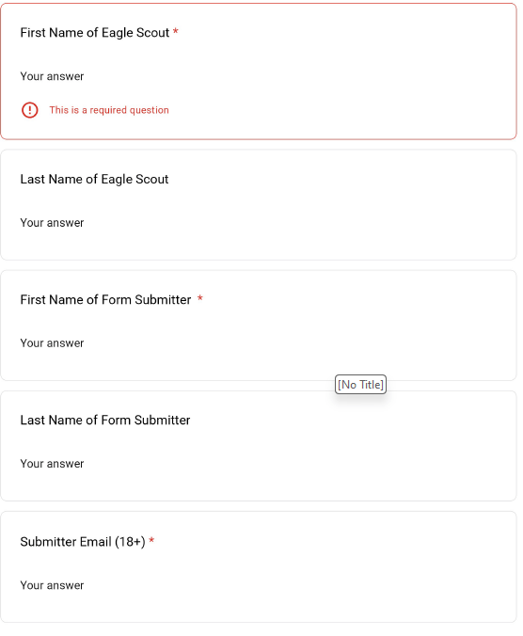

Slide 9
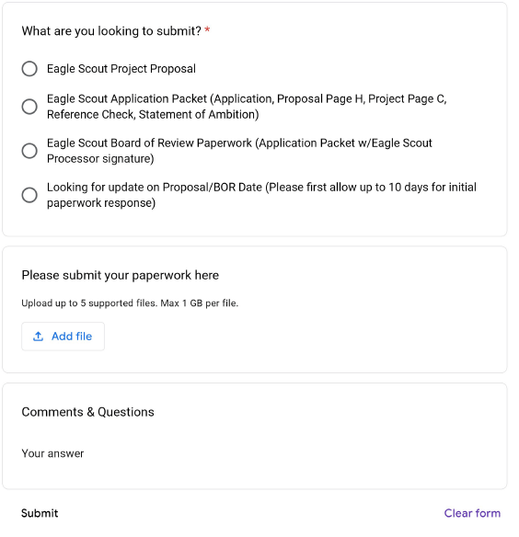

Slide 10

How Do I know My Submission Was Received?
Notes:
You will receive a confirmation email – typically within 5-10 minutes of submission.

Slide 11
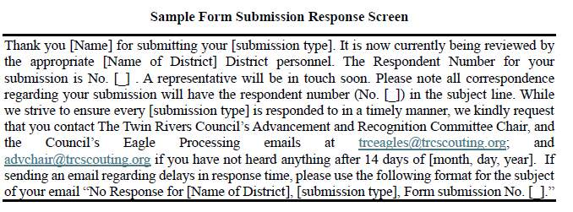

Slide 12
What Happens If The Form Doesn’t Work?
If issues with uploading your Eagle Scout Project occur, you should contact
trceagles@trcscouting.org;
advchair@trcscouting.org ;and
cc your unit leader and District’s Eagle Advancement Chair

Slide 13
Who Do I Contact From My District?
Adirondack:
Jeff Chauvin: chauvinj46@gmail.com
Fort Orange:
Doug Stang: douglasstang@gmail.com
Art Cornell: Arthur.Cornell@scouting.org
Mohawk:
Don Sipher: donsipher@gmail.com
Denise Donnell: dmdonnell71@gmail.com

Slide 14
Who Do I Contact From My District?
Rip Van Winkle District:
Frank Tietjen: ftietjen@hvc.rr.com
Matt White: matman615@gmail.com
Turning Point:
Ellen Howe: wakadvancement@gmail.com
James Maynard: maynardj1986@hotmail.com
Yankee Doodle
Bill Clancy: ydeagles@trcscouting.org

Slide 15
What Do I Need to Submit (Initial Application)
The Project workbook, along with any other relevant materials
(e.g., pictures of the project location if it will help with better understanding your project goals).

Slide 16

What Do I Need to Submit (Board of Review)
Completed application through the three (3) signatures on page 2 of the application.
Completed and Signed Reference Check Acknowledgement Form
Statement of your ambitions & life purpose and listing of positions, honors, and awards
Signature page H from the Eagle Project Proposal which includes four (4) signatures approving the project.
Signature page C from the Eagle Project Report which includes three (3) signatures indicating the project had been completed to everyone’s satisfaction.
Please also include any paper Advancement Forms for correcting advancement and/or troop leadership position dates. If the corrections were made in ScoutBook or Internet Advancement – no paper form is needed.
Notes:
For your Board of Review: There are five (5) required documents that need to be submitted when uploading to the portal:
On The Reference Check Form – Most Districts prefer to see the actual reference; we are working to add a section to the form for references to submit their references directly to the portal.

Slide 17
Thank You
Notes:
Any questions?

